Slide 1

Mathematical Functions, Characters, and Strings
TUIT
C++ Programming, Fall 2016
Lab #4
(I - part)

Slide 2
Read the lecture notes doing following tasks:
TUIT
Practice (I - part)
Geometry: area of a pentagon;
*Geometry: great circle distance;
*Computing angles of triangles;
Geometry: area of a hexagon;
*Geometry: area of a regular polygon;
*Random point on a circle;
*Corner point coordinates;
*Find the character of an ASCII code;
*Find the ASCII code of a character;
*Vowel or constant?;
*Convert an uppercase letter to lowercase;
*Convert letter grade to number;

Slide 3


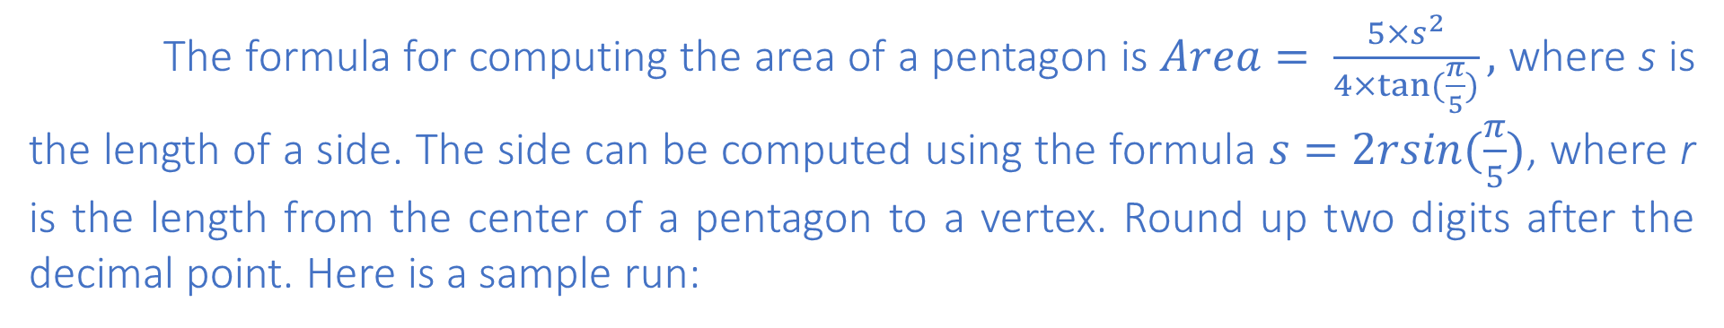
TUIT
1. Geometry: area of a pentagon
Write a program that prompts the user to enter the length from the center of a pentagon to a vertex and computes the area of the pentagon, as shown in the following figure.
r
The formula for computing the area of a pentagon is $Area= \frac{5×s^{2}}{4×tan⁡(\frac{π}{5})},$ where s is the length of a side. The side can be computed using the formula $s=2rsin(\frac{π}{5})$, where r is the length from the center of a pentagon to a vertex. Round up two digits after the decimal point. Here is a sample run:
Enter the length from the center to a vertex: 5.5 The area of the pentagon is 71.92

Slide 4
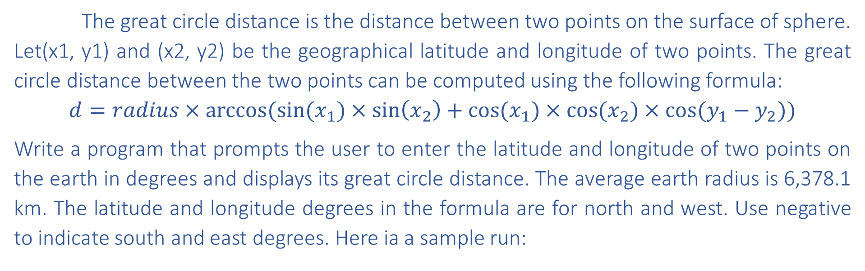
TUIT
2. *Geometry: great circle distance
T
The great circle distance is the distance between two points on the surface of sphere. Let(x1, y1) and (x2, y2) be the geographical latitude and longitude of two points. The great circle distance between the two points can be computed using the following formula:
$$d=radius×arccos⁡(sin⁡(x_{1})×\sin\left(x_{2}\right)+cos⁡(x_{1})×cos⁡(x_{2})×cos⁡(y_{1}−y_{2}))$$
Write a program that prompts the user to enter the latitude and longitude of two points on the earth in degrees and displays its great circle distance. The average earth radius is 6,378.1 km. The latitude and longitude degrees in the formula are for north and west. Use negative to indicate south and east degrees. Here ia a sample run:
Enter point 1 (latitude and longitude) in degrees: 39.55, -116.25 Enter point 2 (latitude and longitude) in degrees: 41.5, 87.37 The distance between the two points is 10691.79183231593 km

Slide 5
TUIT
3. *Computing angles of triangles
ComputeAngles.cpp prompts the user to enter the x – and y – coordinates of the three corner points in a triangle and then displays the triangle’s angles. Write a program that prompts the user to enter the x- and y- coordinates of three corner points of two triangles, displays the triangle’s angles, and then compares whether the angles of both the triangles are equal.

Slide 6
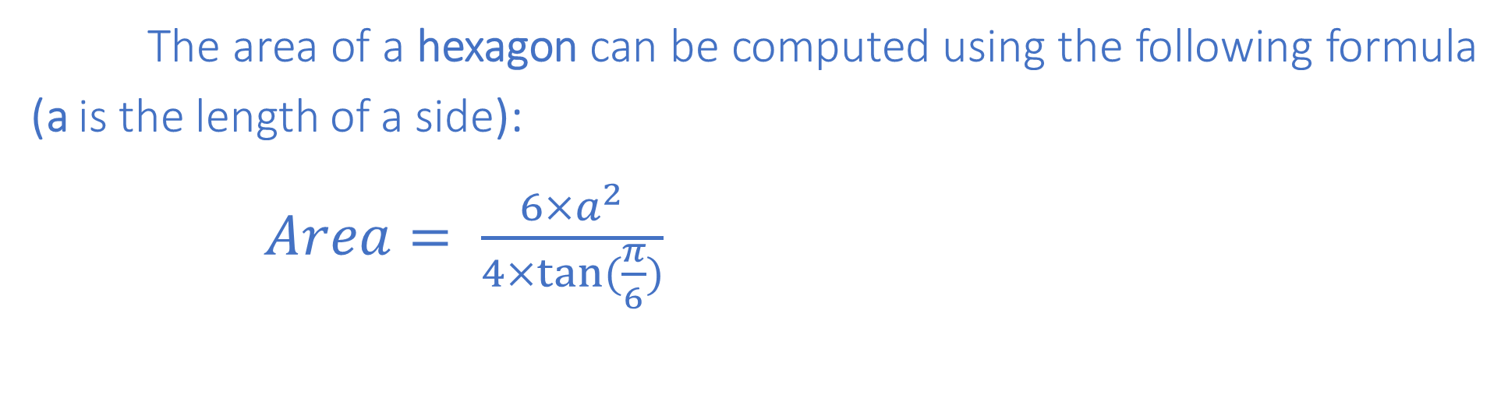
TUIT
4. Geometry: area of a hexagon
The area of a hexagon can be computed using the following formula (a is the length of a side):
$Area= \frac{6×a^{2}}{4×tan⁡(\frac{π}{6})}$
a
Write a program that prompts the user to enter the side of a hexagon and displays its area. Here is a sample run:
Enter the side: 5.5 The area of the hexagon is 78.59

Slide 7
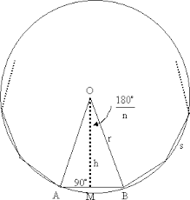

TUIT
5. *Geometry: area of a regular polygon
A regular polygon is an n – sided polygon in which all sides are of the same length and all angles have the same degree (i.e., the polygon is both equilateral and equiangular). The formula the computing the area of a regular polygon is $Area= \frac{n×s^{2}}{4×tan⁡(\frac{π}{n})}$
Here, s is the length of a side. Write a program that prompts the user to enter the number of sides and their length of a regular polygon and displays its area. Here is a sample run:
Enter the number of sides: 5 Enter the side: 6.5 The area of a polygon is 72.69

Slide 8
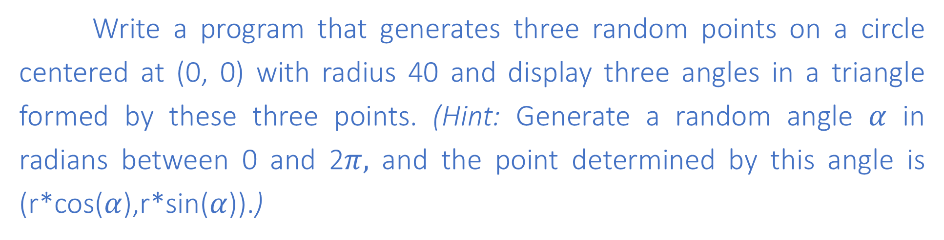




TUIT
6. *Random point on a circle
Write a program that generates three random points on a circle centered at (0, 0) with radius 40 and display three angles in a triangle formed by these three points. (Hint: Generate a random angle $α$ in radians between 0 and 2$π,$ and the point determined by this angle is (r*cos($α$),r*sin($α$)).)
$$x=r×\cos\left(α\right) and y=r×sin⁡(α)$$
0 o’clock position
60
$$r$$
$$α$$
$$r$$
65
(0, 0)
55

Slide 9
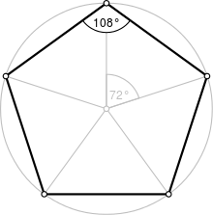
TUIT
7. *Corner point coordinates
Suppose a pentagon is centered at (0, 0) with one point at the 0 o’clock position. Write a program that prompts the user to enter the radius of the bounding circle of a pentagon and displays the coordinates of the five corner points on the pentagon. Here is a sample run:
Enter the radius of the bounding circle: 100 The coordinates of five points on the pentagon are (95.1057, 30.9017) (0.000132679, 100) (-95.1056, 30.9019) (-58.7788, -80.9015) (58.7782, -80.902)

Slide 10
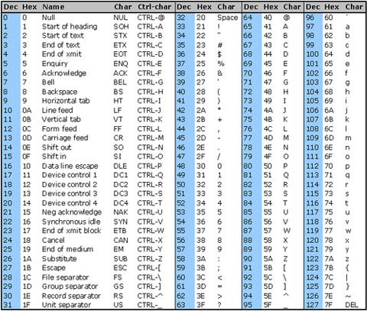
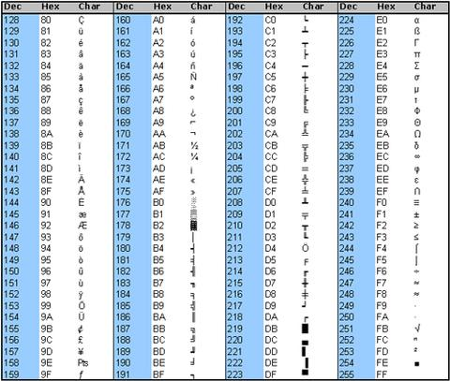
TUIT
8. *Find the character of an ASCII code
Write a program that receives an ASCII code (an integer between 0 and 127) and displays is character.
Here is a sample run:
Enter an ASCII code: 69 The character is E

Slide 11
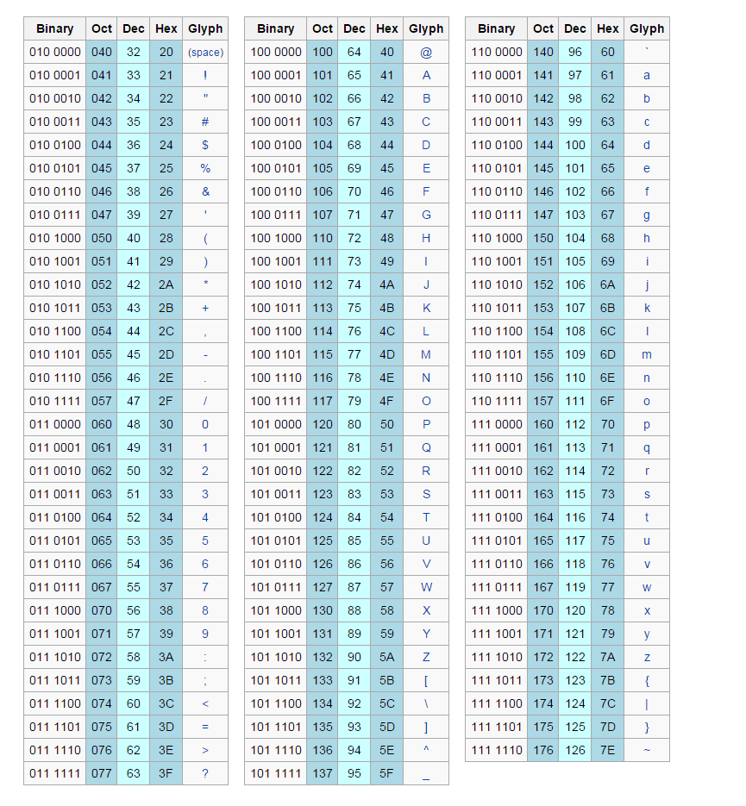
TUIT
9. *Find the ASCII code of a character
Write a program that receives a character and displays its ASCII code.
Here is a sample run:
Enter a character: E The ASCII code for the character is 69

Slide 12
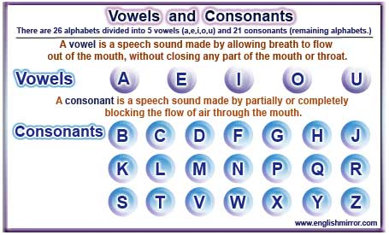
TUIT
10. *Vowel or consonant?
Assume letters A/a, E/e, I/i, O/o, and U/u as the vowels. Write a program that prompts the user to enter a letter and check whether the letter is a vowel or consonant.
Here is a sample run:
Enter a letter: B B is a consonant
Enter a letter: a a is a vowel
Enter a letter: # # is an invalid input

Slide 13
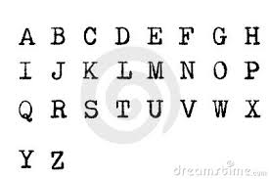
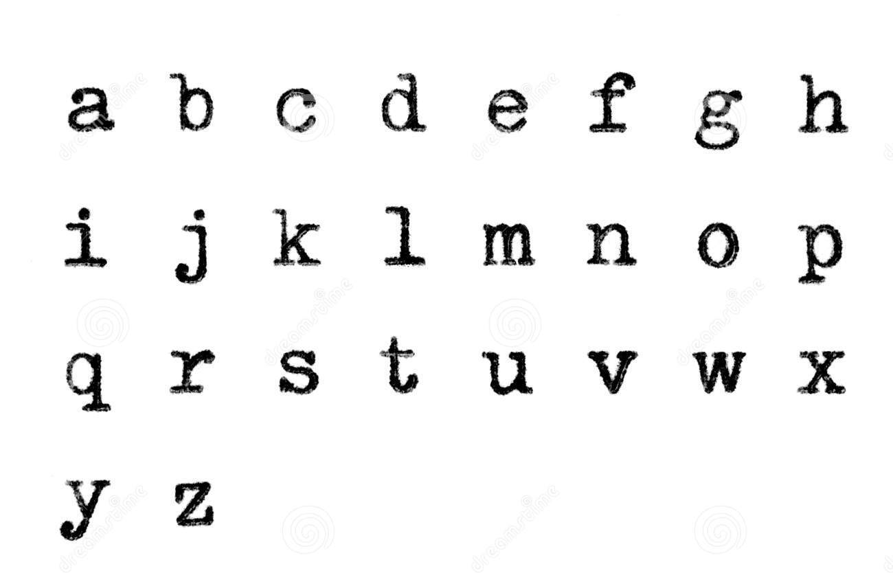
TUIT
11. * Convert an uppercase letter to lowercase
Write a program that prompts the user to enter an uppercase letter and converts it to a lowercase letter.
Enter un uppercase letter: T The lowercase letter is t

Slide 14
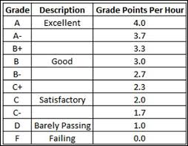
TUIT
12. *Convert letter grade to number
Write a program that prompts the user to enter a letter grade A/a, B/b, C/c, D/d, or F/f and displays its corresponding numeric value 4, 3, 2, 1, or 0.
Here is a sample runs:
Enter a letter grade: B The numeric value for grade B is 3
Enter a letter grade: b The numeric value for grade b is 3
Enter a letter grade: T T is an invalid grade

